Slide 1
UNDERGRADUATE STUDENT SUCCESS RECRUITMENT, RETENTION, AND GRADUATION ACADEMIC LEADERSHIP RETREAT AUGUST 2017

Slide 2
RETENTION AND ENROLLMENT
2018 Undergraduate Enrollment Goals
Today’s Focus
New Freshmen
2018: 4,950 to 5,000
2016: 4,851
New Transfers
2018: 1,350 to 1,385
2016: 1,367
First-Year Retention
2018: 88%
2016: 86%

Slide 3
RETENTION DRIVERS
Four primary and inter-connected drivers impact student attrition.
Academic Preparation (High School)
Personal Fit/ Wellness
Financial/ Ability to Pay
Academic Progress
To address these issues, the strategic enrollment retention plan focuses on:
Affordability
Academic Progress
Volunteer Experience

Slide 4
RETENTION IMPROVEMENT STRATEGY
92% First-to-Second Year Retention by 2022
Incoming Class of 2017 Goal – 88% retention
1% increase per year for the next four years
Help Students Make Academic Progress
Reimagine the Volunteer Student Experience
Maintain Affordability

Slide 5
RECRUITMENT
UTK’s incoming freshmen ACT profile is comparable or exceeds over half of the Southern peer set (SEC and public flagship and land grant schools in the southeast).
Incoming Student ACT Equivalent Range – 75th and 25th Percentile, Fall 2015
UTK vs. Southern Peer Set (SEC + Southeast Flagship or Land Grant Schools)
Source: US News 2017 Rankings

Slide 6
RETENTION
However, UTK’s retention rate falls near the lower end of a comparative group.
Retention Rates, Fall 2015 (2014 Cohort)
UTK vs. Southern Peer Set (SEC + Southeast Flagship or Land Grant Schools)
SEP Plan Goal by 2022
2017 - 2018 Goal
Source: IPEDS

Slide 7
RETENTION
Retention patterns have improved over time, but at a slow and fluctuating pace.
Retention Rates by Cohort Year,
Fall 2006 to 2015
SEP Plan Goal by 2022
2017 – 2018 Goal
Notes:
Add in current projections to notes: 86%
-

Slide 8
GRADUATION
While retention remained flat, a consistent trajectory of improvement in “on time” graduation rates over ten years drove past six-year graduation progress.
Graduation Rates by Cohort Year
Fall 2002 to 2012

Slide 9
GRADUATION
UTK is near the midpoint in graduation rates when compared to leading public universities in the Southeast region.
Graduation Rates, Fall 2015
UTK vs. Southern Peer Set (SEC + Southeast Flagship or Land Grant Schools)
SEP Plan Goal by 2022
Source: IPEDS

Slide 10
RETENTION IMPROVEMENT STRATEGY
Help Students Make Academic Progress
Reimagine the Volunteer Student Experience
Maintain Affordability

Slide 11
STUDENT FINANCIAL PICTURE
A large number of UTK undergraduates have low family incomes.
All Undergraduates by Adjusted Gross Income Grouping
2015
27%
Less than $50K
Adjusted Gross
29%
Pell Eligible (2014 Data)
25%
First Generation (2014 Data)

Slide 12
UTK has a higher percentage of students receiving Pell Grant assistance compared to the Southern peer set, making affordability a more pronounced challenge.
AFFORDABILITY – PELL GRANT
Percentage of Students Receiving Pell Grants, 2014
UTK vs. Southern Peer Set (SEC + Southeast Flagship or Land Grant Schools)
Source: IPEDS
Notes:
Pell % for 2014: 31% (need to confirm)

Slide 13
Nearly 40% of Hope scholarship students will lose eligibility or transfer out by their senior year.
AFFORDABLITY – LOSING HOPE
Percentage of Students Losing Hope Scholarship (Eligibility or Transfer), By Cohort and Year
Fall 2005 to 2014 Cohorts
~10%
“Lose Hope”
After Year 3
~30%
“Lose Hope”
After Year 1

Slide 14
RETENTION IMPROVEMENT STRATEGY
Help Students Make Academic Progress
Reimagine the Volunteer Student Experience
Maintain Affordability
Retention of Hope and Financial Aid Campaign
Bridge Back to Hope Funding
Increase in Work Study/ On-Campus Jobs
Targeted Increase in Need-Based Aid
Financial Wellness Program Launch

Slide 15
RETENTION IMPROVEMENT STRATEGY
Help Students Make Academic Progress
Reimagine the Volunteer Student Experience
Maintain Affordability

Slide 16
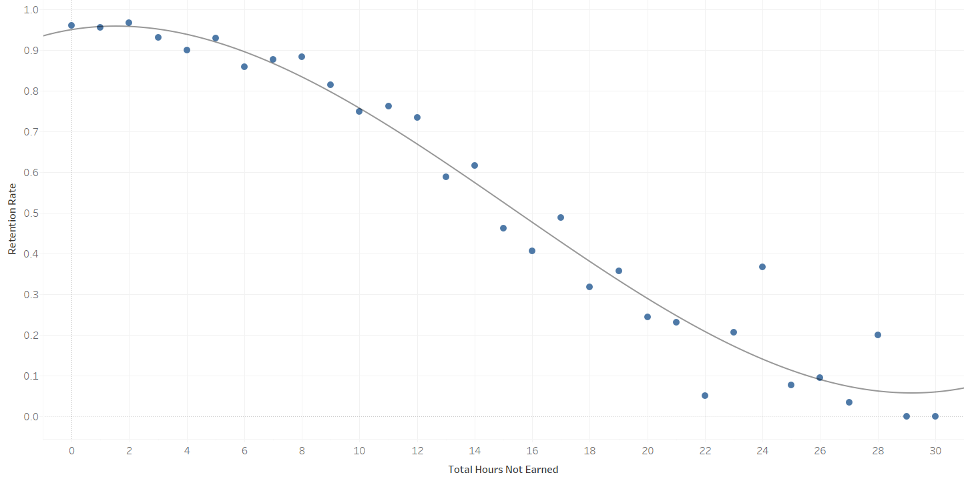
ACADEMIC PROGRESS - SLIPPERY SLOPE
The more hours a student fails to earn during their Freshman year, the less likely they are to return for their second year.
Retention Rate vs. Total Unearned Hours
The “slippery slope” can start when students fail to earn at least 3 hours
Note: Work by Bryce Curtsinger and Tanner Martin, Haslam College of Business (Provost Interns 2017)

Slide 17
ACADEMIC PROGRESS -- FALL VS. SPRING PERFORMANCE
Students who encounter challenges in the fall semester, but perform well in the spring semester are more likely to retain. Early intervention in the target group could impact 16% of students.
Retention Rates by Unearned Hours in Both Semesters
0
1 to 3
4 to 6
7 to 9
10+
0
1 to 3
4 to 6
7 to 9
10+
Note: Work by Bryce Curtsinger and Tanner Martin, Haslam College of Business (Provost Interns 2017)

Slide 18
ACADEMIC PROGRESS -- UNEARNED HOURS VS. GPA
Many students who leave are not even on the university’s radar. The mean GPA in many of the blue boxes is above the 2.0 cutoff that defines academic probation.
Retention Rates by Unearned Hours in Both Semesters
0
1 to 3
4 to 6
7 to 9
10+
0
1 to 3
4 to 6
7 to 9
10+
Note: Work by Bryce Curtsinger and Tanner Martin, Haslam College of Business (Provost Interns 2017)

Slide 19
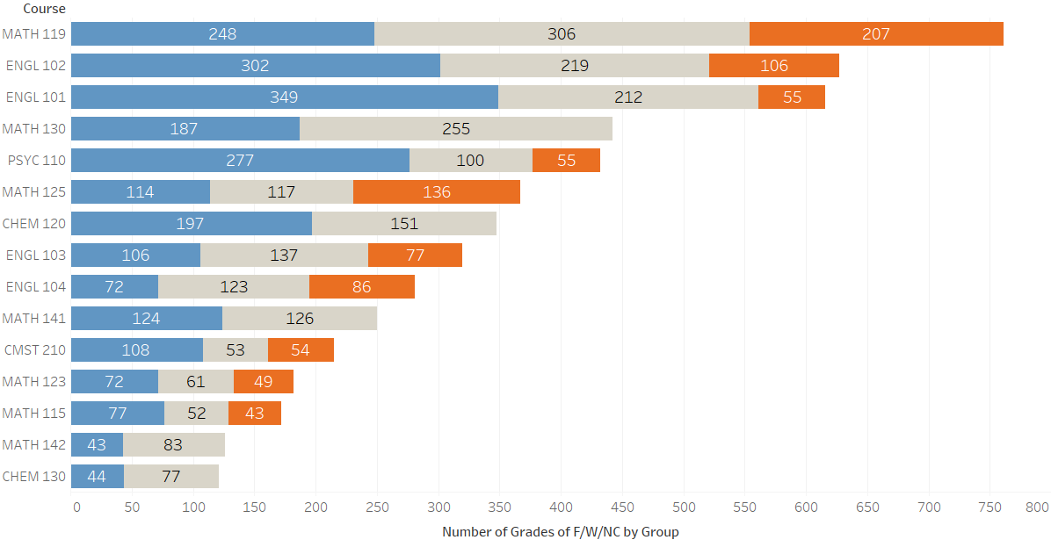
ACADEMIC PROGRESS - CLASS SUCCESS
The highest unearned hours across all groups fall in Math and English.
Top 15 Classes by Unearned Hours
Fall 2013 to Spring 2016
15 classes = 36% of all classes taken by freshmen
16% of freshman grades in these 15 classes are F/NC/W
10% of freshman grades in all other classes are F/NC/W
Note: Work by Bryce Curtsinger and Tanner Martin, Haslam College of Business (Provost Interns 2017)

Slide 20
ACADEMIC PROGRESS – EARLY INTERVENTION
4.5% of FTF students leave after Fall semester. Some are high achievers who leave for financial or “fit” reasons. Many experience academic difficulty; early warning signals can help identify them.
Fall term GPA
> 3.5
3.0 – 3.5
2.5 – 3.0
2.0 – 2.5
< 2.0
100%
80 – 99%
Fall hours earned
67 – 80%
below 67%

Slide 21
ACADEMIC PROGRESS – FINISH STRONG
9.8% of FTF students leave after Spring semester. Many are in good academic standing but have a low hours-earned ratio. Use warning signals from Fall to create a “finish strong” strategy for Spring.
Full year GPA
> 3.5
3.0 – 3.5
2.5 – 3.0
2.0 – 2.5
< 2.0
100%
90 – 99%
Year hours earned
67 – 90%
below 67%

Slide 22
RETENTION IMPROVEMENT STRATEGY
New Advising Model
Math Success Initiatives
Finish Strong Campaign - Aggressive Early Intervention
Course Completion Initiatives
Teaching Innovation/ e-Learning
Degree Pathways/ Curricular Redesign
Help Students Make Academic Progress
Reimagine the Volunteer Student Experience
Maintain Affordability

Slide 23
RETENTION IMPROVEMENT STRATEGY
Help Students Make Academic Progress
Reimagine the Volunteer Student Experience
Maintain Affordability

Slide 24
VOLUNTEER EXPERIENCE
Re-imagining the Volunteer Experience and delivering a differentiated student experience is intended to support recruitment and retention.
Launch new leadership program modeled after Vol Leaders and Honors Leaders
Signature Leadership Program
Scholarship Strategy Redesign
Marketing Campaign
Volunteer Family/ Alumni
Student Experience & Programs
Align key Student Life programs (Ignite), general education, and experience learning around Volunteer Experience theme
Designed to attract right fit students and incentivize positive academic performance and support persistence and graduation
Volunteer
Experience:
Lead
Serve
Bear the Torch
Engage alumni throughout the student experience – recruitment, retention, post-graduation
Develop and implement marketing plan in support of enrollment goals, including custom campaigns in target recruitment markets

Slide 25
RETENTION IMPROVEMENT STRATEGY
New Advising Model
Math Success Initiatives
Finish Strong Campaign - Aggressive Early Intervention
Course Completion Initiatives
Teaching Innovation/ e-Learning
Degree Pathways/ Curricular Redesign
Help Students Make Academic Progress
Reimagine the Volunteer Student Experience
Maintain Affordability
Retention of Hope and Financial Aid Campaign
Bridge Back to Hope Funding
Increase in Work Study/ On-Campus Jobs
Targeted Increase in Need-Based Aid
Financial Wellness Program Launch
New First-Year Experience
Student Life/ Residential Programs
Signature Leadership Program
Experience Learning
Vol Career Network

Slide 26
NEXT STEPS FOR DEANS, DEPARTMENT HEADS AND DIRECTORS
EXAMPLES
Academic Progress Initiatives
Course Redesign
Reexamine Placement Criteria
Advising Implementation
Finish Strong
Degree Pathways
Retention of Financial Aid and Hope
Coordination with Student Success, Student Life, Financial Aid, Enrollment, and QEP
Early Alert for Academic Progress
Student Life/ QEP Initiatives (e.g. LLCs, UG Research, Service Learning)
Work Study
Early Allocation of Department/College Scholarships
College-Level Enrollment Planning (Start - Fall 2017 to Spring 2018)

